Slide 1
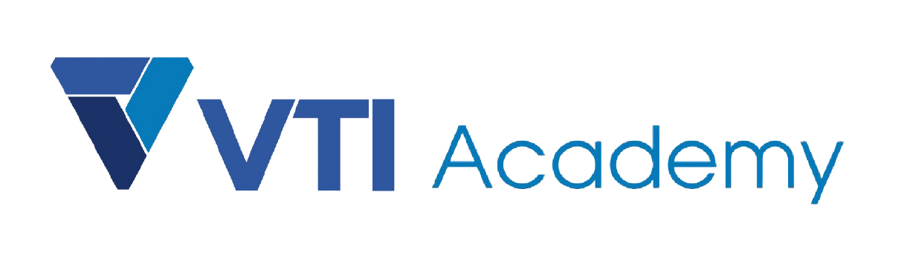
WAY TO ENTERPRISE
AWS
VTI ACADEMY
Author: duy.nguyenngoc1@vti.com.vn

Slide 2
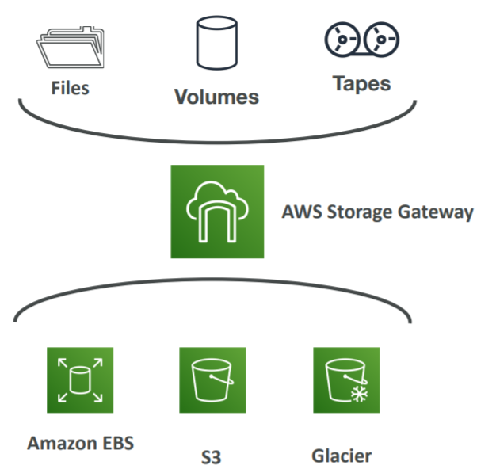
Storage Gateway Service
Is a bridge between on-premises data and cloud data in S3
Usecases
  Using for Hybrid Cloud for Storage
  Disaster recovery, backup & restore, tiered storage
Price: https://aws.amazon.com/storagegateway/pricing
https://docs.aws.amazon.com/storagegateway/latest/userguide/WhatIsStorageGateway.html

Slide 3
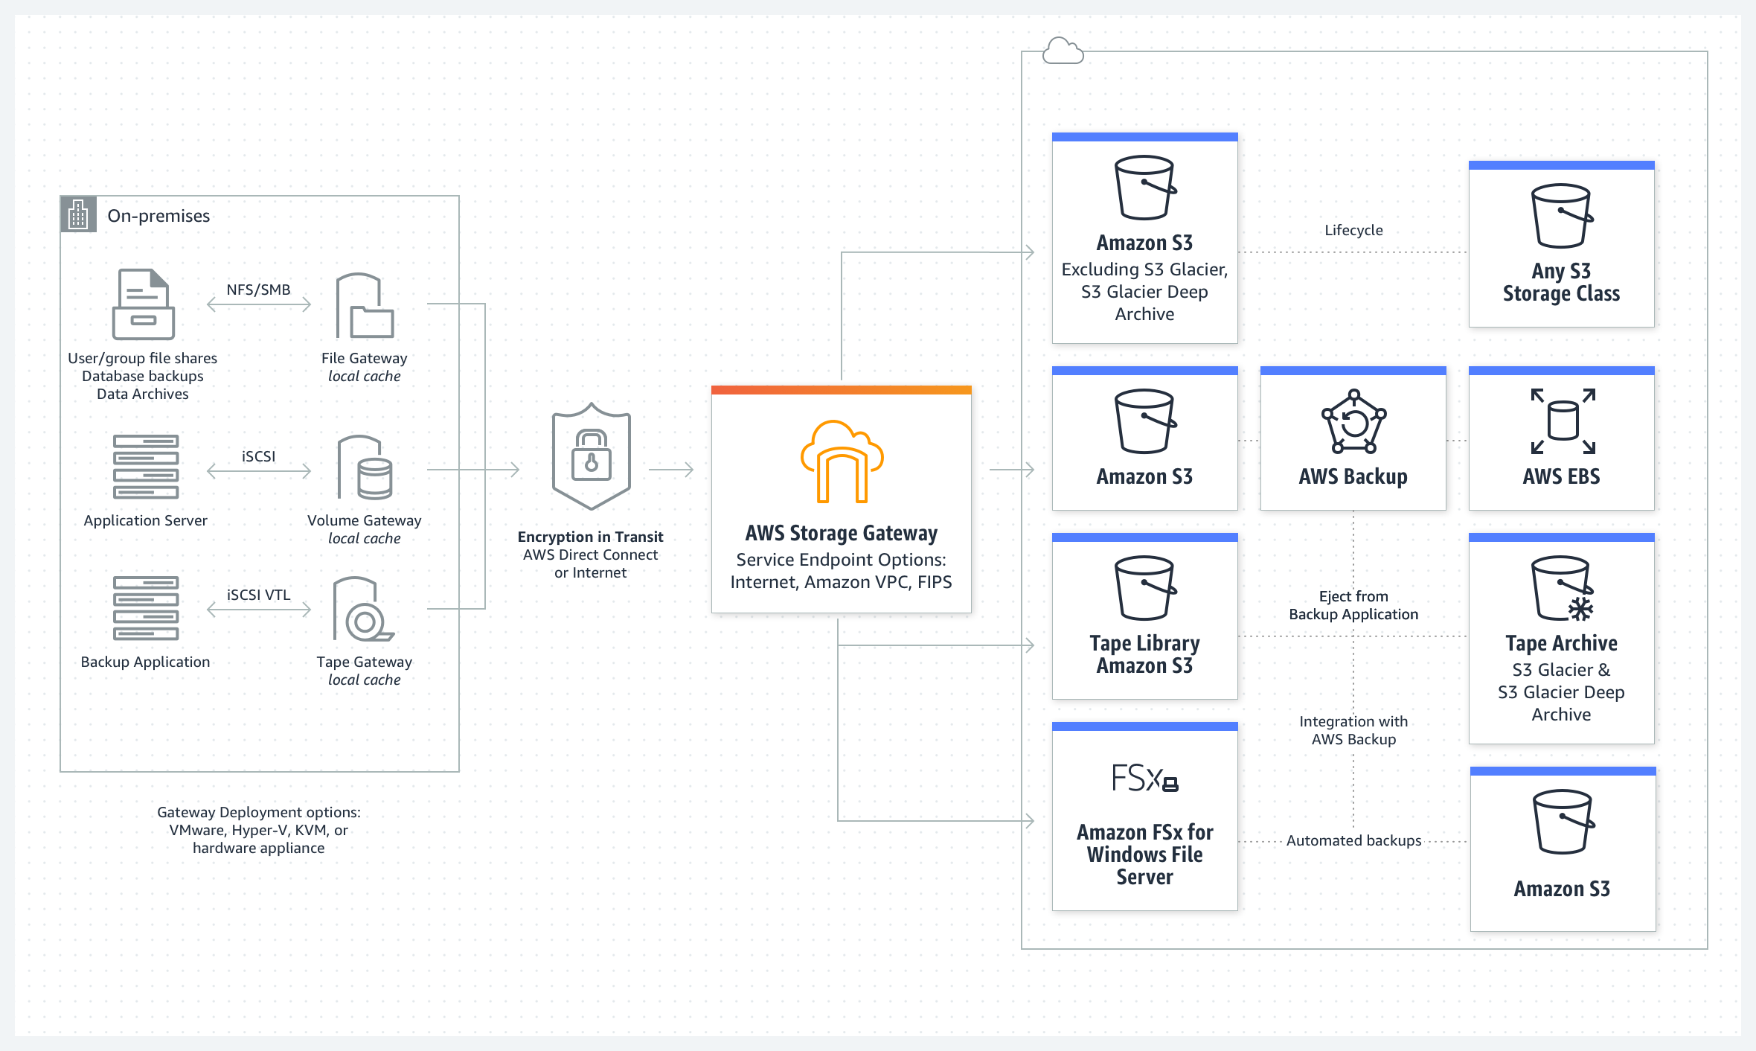
Storage Gateway Service
Types
  File Gateway
  Volume Gateway
  Tape Gateway
  FSx File Gateway

Slide 4
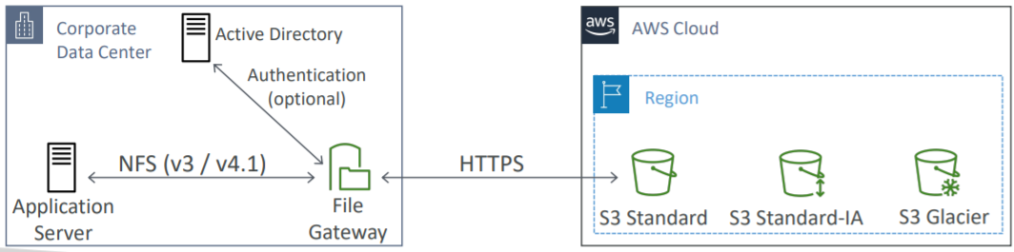
Storage Gateway Service
  File Gateway (S3 File Gateway)
    Configured S3 buckets are accessible using the NFS and SMB protocol
    Bucket access using IAM roles for each File Gateway
    Most recently used data is cached in the file gateway
    Integrated with Active Directory (AD) for user authentication
Supports S3 standard, standard-IA, One Zone-IA

Slide 5
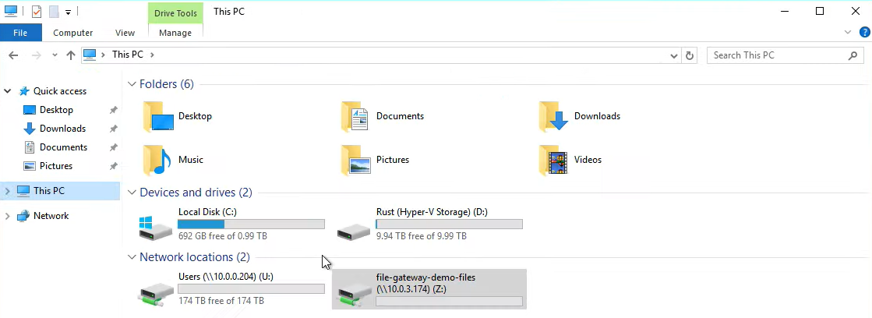
Storage Gateway Service
    Can be mounted on many servers
    Use Multipart Uploads and Byte-range fetches to sync large files between S3 & gateway
    Support file versioning
Tutorial: https://www.youtube.com/watch?v=QaCfOatTIDA

Slide 6
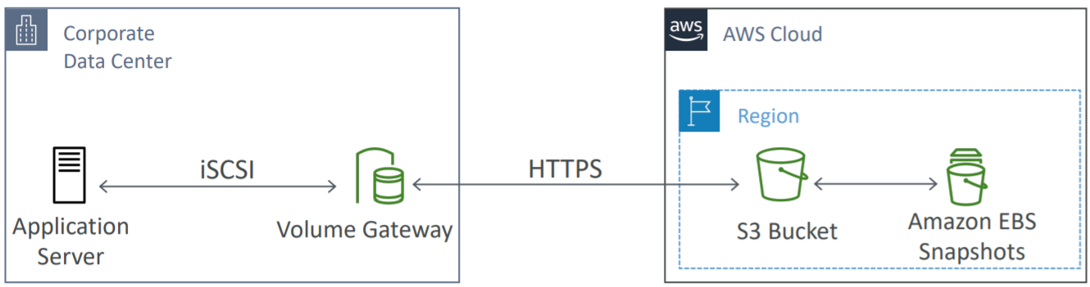
Storage Gateway Service
  Volume Gateway
    To snapshot data from the drive in on-premises to the EBS snapshot
    2 types
      Cached volumes
      Stored volumes

Slide 7
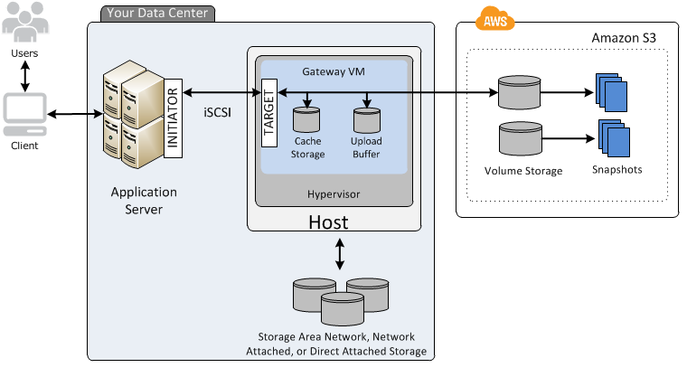
Storage Gateway Service
    Cached volumes
      Low latency access to most recent data
      Using S3 as a primary data storage of the computer
      Max 32 Cache volume, Cache volume size is from 1GB to 32TB
      Usecases: extends hard drive in on-premises

Slide 8
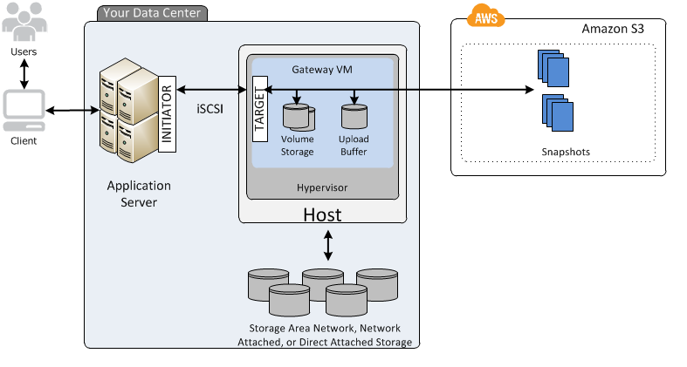
Storage Gateway Service
    Store volumes
      Backup entire hard drive in on-premises to S3 snapshot
      Max 32 Cache volume, Cache volume size is from 1GB to 16TB
      Usecases: esed to backup hard drive in on-premises to cloud
Tutorial: https://www.youtube.com/watch?v=Bb8nk0oWJbU

Slide 9
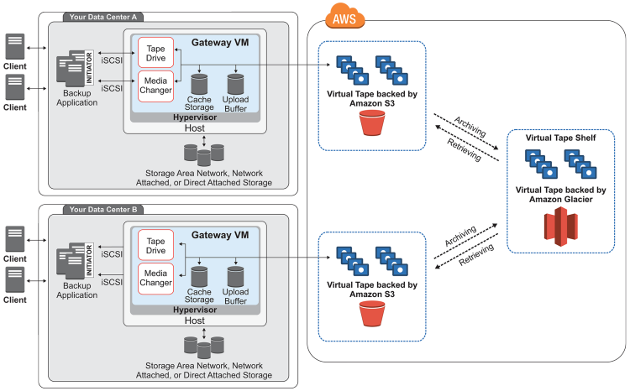
Storage Gateway Service
  Tape Gateway
    Used to backup data in tape on-premises to S3
    Virtual Tape Library (VTL) backed by Amazon S3 and Glacier

Slide 10
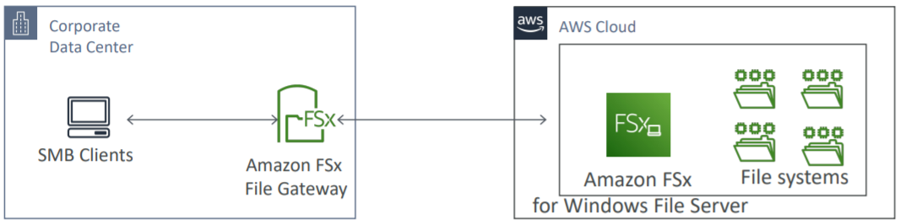
Storage Gateway Service
  FSx File Gateway
    Optimize access to FSx for Windows File Server
    Support local cache for frequently accessed data

Slide 11
Storage Gateway Service
Components
  Gateway VM
    Type: File Gateway, Volume gateway, Tape gateway
    Host platform: hypervisor ở on-premises, support VMware, Microsoft Hyper-V, Linux KVM
    Local disk: Support Cache storage and Upload buffer
  Hardware appliance
  File Share

Slide 12
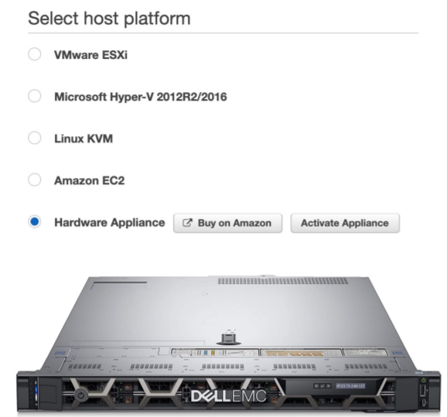
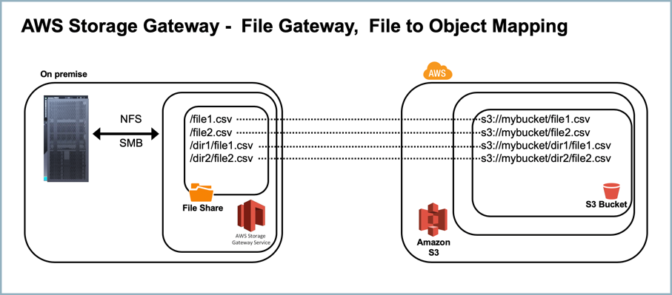
Storage Gateway Service
  Hardware appliance
    Is a physical device
    Has the required CPU, memory, network, SSD cache resources
    Size: 5TB 🡪 12TB
    Buy it on amazon.com
    Extremely expensive
  File Share
    Is S3 bucket, where to stored file
Hardware appliance
File Share

Slide 13
Assignment
  Self-practice

Slide 14
Storage Gateway Service
Summary
  File access, user auth with Active Directory 🡺 File Gateway
  On-premises data to the cloud 🡺 Storage Gateway
    Use the volume as a drive in on-premises 🡺 Cached Volume
    Backup entire drive in on-premises to Snapshot in the cloud 🡺 Stored Volume
  VTL Tape Backup solution 🡺 Tape Gateway
  No on-premises virtualization 🡺 Hardware Appliance
  FSx for Windows File Server 🡺 FSx File Gateway

Slide 15
Q & A
Copyright © VTI Academy All Rights Reserved

